Slide 1
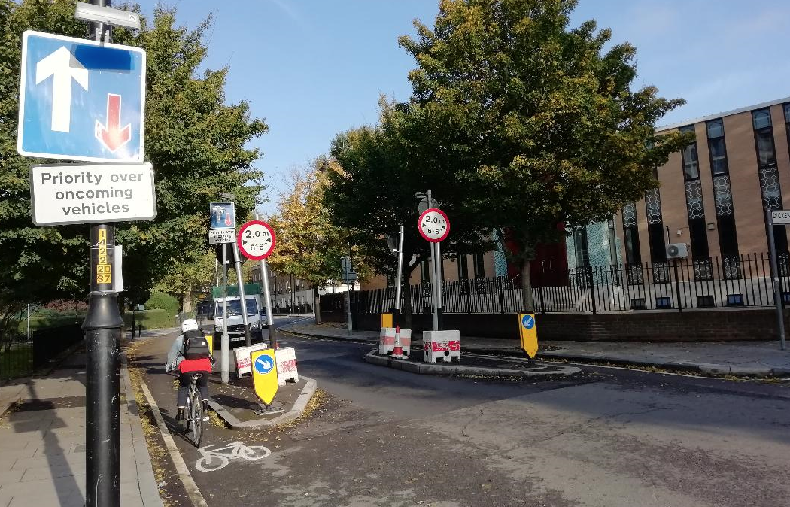
Width restriction at Harper Road and Bath Terrace - Summary notes on traffic monitoring results and feedback
Photo of width restriction at Harper Road, October 2018
Transport Projects
Highways
Southwark Council
Version 3 (Table 3- information added, Table 2 % values corrected)
Date: 31/10/2018

Slide 2
Introduction and method
Width restrictions were installed in Harper Road and Bath Terrace, under an Experimental Traffic order, in March 2018. Due to vandalism, the feature at Harper Road was reinforced on three occasions.
An online feedback questionnaire was made available for feedback and the project manager and highways email addresses were available for email submissions. Emergency services were actively engaged during the whole monitoring period.
Baseline traffic counts were gathered in 2017 and follow up data was collected in September 2018 (see Figure 1 for locations) to compare traffic volumes and proportion of % large vehicles (i.e. HGVs) as per Healthy Street criteria.
The data analysed was ARX classes 5-12 (see Figure 2) compared to total motorised vehicles, between 7am and 7pm, on an average day. Peak-hour flows for Harper Road were also analysed, as were indicative DfT classified counts for cyclists.
Results and analysis
The feedback during the monitoring period included submission to the online questionnaire as well as emails from residents, resident associations and the emergency services. Overall feedback was positive with reports of decreased HGVs and related vibration and noise, and a more pleasant environment for cycling. Cyclists and Southwark Cyclists have requested for a road closure to further reduce general through traffic. The emergency services requested a modified width restriction to ensure access to Rockingham Estate.

Slide 3
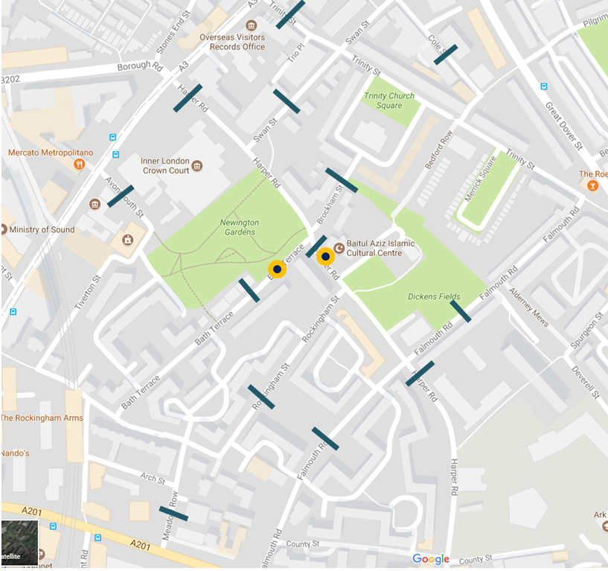
Figure 1. Width restriction traffic count locations
Automated Traffic Counts (ATCs) taken September 2018
Locations of width restrictions
3

Slide 4
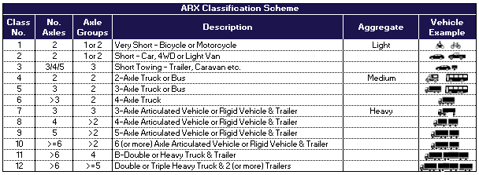
Figure 2. ARX classification of large vehicles (i.e. HGVs)
Large vehicles

Slide 5
Results and analysis (cont.)
Baseline traffic data before the width restriction showed that the proportion of HGVs was initially high (above 5%) in a number of locations in the area (%, actual number of HGVs/total traffic) (see Table 3).
Table 1. Pre-width restriction traffic numbers for locations with high %HGV
Monitoring traffic data , with the restriction in place, showed that the proportion of HGVs dropped in Harper Road and Brockham Street. The proportion remained above 5% in Trinity Street and Meadow Row, however actual numbers dropped (see Table 3). In Harper Road there was a reduction of 86% HGVs and 23% (889) motorised vehicles.
Table 2. Pre-width restriction traffic numbers for locations with high %HGV
 | Total traffic | Number HGV | % HGV
Harper Road - middle | 3810 | 219 | 5.8%
Trinity Street | 1613 | 177 | 11.0%
Brockham Street | 771 | 91 | 11.8%
Meadow Row | 720 | 80 | 11.2%
 | Total traffic | Number HGV | % HGV
Harper Road - middle | 2921 | 29 | 1.0%
Trinity Street | 1597 | 140 | 8.8%
Brockham Street | 484 | 17 | 3.5%
Meadow Row | 580 | 67 | 11.6%

Slide 6
Results and analysis (cont)
HGV traffic in side streets to the north of Harper Road has decreased. Other traffic has increased slightly. In Cole Street the HGV traffic reduced slightly from 7 to 6 vehicles but overall traffic increased from 227 to 259. In the section of Falmouth Road which links Cole Street/Globe Street/Trinity Street to Harper Road, the overall traffic increased from 231 to 262 (by 32 vehicles). This represents 3% of the traffic that no longer travels through the middle of Harper Rd (889 vehicles) (see Table 3). A certain number of large vehicles visit Trinity Street regularly for rehearsals at Henry Wood Hall, which may explain the proportion of large vehicles there remaining at 8.8%.
HGV traffic in side streets to the south of Harper Road has decreased except in Avonmouth Road where it increased slightly from 7 to 10 vehicles and Bath Terrace where it increased from 3 to 15 (presumably to access the Estate). The overall numbers in Avonmouth Road increased by 83 from 408 to 491 however numbers in adjoining streets (Bath Terrace and Meadow Row) do not have corresponding figures that would indicate through running (see Table 3). Although HGV traffic increased as a proportion of total traffic in Falmouth Road from 4% to 5.9%, the total number of HGVs vehicles remained unchanged (22) and the increase in % HGV figure due to overall traffic decreasing by 175 vehicles (see Table 3).
DfT cycle classified counts have shown that cycle numbers in the area have increased along routes: up 76% from 201 to 354 in Falmouth Road south (quietway 7), up 25% from 368 to 462 in Meadow Row (LCN route), and up 29% through the middle of Harper Road (future quietway/Southwark Spine) (see Table 4). Manual traffic counts would confirm the numbers.
PM hourly peak flows in Harper Road (middle section) showed a drop of 24% (from 534 to 405. These reflect 6pm-7pm, ARX traffic two way, Thurs 19 Oct 2017 vs Tues 25 Sept 2018, excluding respective DfT pedal cyclists numbers (80/82) )(see Figures 3 and 4).

Slide 7
Table 3. Change in proportion/number of HGVs and total motorised traffic since width restrictions
 | %HGV before and after width restriction |  | Total number motorised vehicles with width restriction | Change in total motorised vehicles compared to 2017 figures | Total number HGVs with width restriction | Change in HGV numbers compared to 2017 figures | % change in HGV numbers | % change in all motorised traffic traffic | % change in pedal cycle numbers (indicative DfT)
 | 2017 | Sep 2018
Harper Rd 1 | 2.2% | 1.3% | 2978 | -275 | 38 | -33 | -47% | -8% | 29%
Harper Rd 2 | 5.8% | 1.0% | 2921 | -889 | 29 | -191 | -87% | -23% | -64%
Harper Rd 3 | 3.1% | 1.3% | 2856 | -100 | 38 | -54 | -59% | -3% | -13%
Trinity St | 11.0% | 8.8% | 1597 | -16 | 140 | -37 | -21% | -1% | 2%
Brockham St | 11.8% | 3.6% | 484 | -286 | 17 | -74 | -81% | -37% | 22%
Cole Street | 3.5% | 2.5% | 259 | 32 | 6 | -1 | -19% | 14% | -10%
Swan Street | 2.2% | 1.2% | 370 | -209 | 4 | -9 | -67% | -36% | -7%
Falmouth Rd N | 2.5% | 2.7% | 262 | 31 | 7 | 1 | 23% | 13% | -2%
Falmouth Rd S | 4.0% | 5.9% | 370 | -175 | 22 | 0 | 0% | -32% | 76%
Meadow Row | 11.2% | 11.6% | 580 | -140 | 67 | -13 | -17% | -20% | 25%
Rockingham Street | 4.3% | 1.4% | 258 | 5 | 4 | -7 | -67% | 2% | 921%
Avonmouth Rd | 1.6% | 2.0% | 491 | 83 | 10 | 3 | 48% | 20% | 236%
Bath Terrace | 0.7% | 4.9% | 303 | -78 | 15 | 12 | 478% | -20% | 0%

Slide 8
Table 4. Classified data (ARX output)
Classified counts 7am-7pm - summary
BEFORE: 2017 baseline counts: Number of vehicles - classified, 7-19, two way, average 7 day week
 | Pedal Cycles- DfT | Motorcycles +PC) ARX | Cars |  | Cars with trailer | LGV | Lorry/Bus | Lorry | Lorry | Lorry | Lorry | Lorry | Lorry | Lorry | Total motorised (excl Dft PC) | Total HGVs | % HGV
ARX Class | N/A | 1 | 2 |  | 3 | 4 | 5 | 6 | 7 | 8 | 9 | 10 | 11 | 12
Harper Rd 1 | 220 | 512 | 2396 |  | 18 | 477 | 18 | 38 | 2 | 6 | 1 | 4 | 0 | 1 | 3254 | 70 | 2.2%
Harper Rd 2 | 408 | 705 | 3130 |  | 28 | 137 | 95 | 95 | 2 | 8 | 3 | 12 | 1 | 2 | 3810 | 219 | 5.8%
Harper Rd 3 | 215 | 464 | 2242 |  | 21 | 352 | 68 | 21 | 0 | 2 | 0 | 1 | 0 | 0 | 2956 | 92 | 3.1%
Trinity St | 851 | 1097 | 1052 |  | 7 | 131 | 30 | 107 | 1 | 3 | 2 | 21 | 7 | 5 | 1613 | 177 | 11.0%
Cole Street | 109 | 136 | 169 |  | 0 | 24 | 3 | 4 | 0 | 0 | 0 | 0 | 0 | 0 | 228 | 8 | 3.5%
Swan Street | 120 | 236 | 381 |  | 1 | 68 | 8 | 3 | 1 | 0 | 0 | 1 | 0 | 0 | 579 | 13 | 2.2%
Falmouth Rd N | 254 | 251 | 200 |  | 1 | 28 | 1 | 4 | 0 | 0 | 0 | 0 | 0 | 0 | 231 | 6 | 2.5%
Falmouth Rd S | 201 | 357 | 320 |  | 0 | 47 | 1 | 20 | 0 | 0 | 0 | 0 | 1 | 0 | 545 | 22 | 4.0%
Meadow Row | 368 | 557 | 392 |  | 1 | 58 | 4 | 57 | 0 | 1 | 1 | 12 | 3 | 3 | 720 | 80 | 11.2%
Rockingham St | 2 | 29 | 187 |  | 0 | 28 | 1 | 10 | 0 | 0 | 0 | 0 | 0 | 0 | 253 | 11 | 4.3%
Brockham St | 261 | 464 | 468 |  | 1 | 8 | 51 | 36 | 0 | 0 | 1 | 3 | 0 | 1 | 771 | 91 | 11.8%
Avonmouth St | 9 | 54 | 305 |  | 0 | 51 | 5 | 1 | 0 | 0 | 0 | 0 | 0 | 0 | 408 | 7 | 1.6%
Bath Tce | 70 | 113 | 324 |  | 0 | 11 | 0 | 2 | 0 | 0 | 0 | 0 | 0 | 0 | 381 | 3 | 0.7%
AFTER: 2018 (Sept) monitoring counts: Number of vehicles - classified, 7-19, two way, average 7 day week
 | Pedal Cycles- DfT | MC (+PC) | Cars |  | Cars with trailer | LGV | Lorry/Bus | Lorry | Lorry | Lorry | Lorry | Lorry | Lorry | Lorry | Total motorised (excl Dft PC) | Total HGVs | % HGV
ARX Class | N/A | 1 | 2 |  | 3 | 4 | 5 | 6 | 7 | 8 | 9 | 10 | 11 | 12
Harper Rd 1 | 283 | 553 | 2261 |  | 17 | 393 | 9 | 18 | 2 | 4 | 1 | 2 | 0 | 1 | 2978 | 38 | 1.3%
Harper Rd 2 | 147 | 397 | 2429 |  | 18 | 195 | 4 | 11 | 5 | 4 | 0 | 4 | 0 | 1 | 2921 | 29 | 1.0%
Harper Rd 3 | 187 | 467 | 2113 |  | 20 | 404 | 9 | 15 | 4 | 6 | 1 | 3 | 0 | 0 | 2856 | 38 | 1.3%
Trinity St | 871 | 1089 | 1068 |  | 6 | 163 | 9 | 92 | 1 | 2 | 2 | 22 | 6 | 6 | 1597 | 140 | 8.8%
Cole Street | 98 | 126 | 186 |  | 1 | 38 | 2 | 3 | 0 | 0 | 0 | 1 | 0 | 0 | 259 | 6 | 2.5%
Swan Street | 112 | 167 | 259 |  | 1 | 50 | 2 | 2 | 0 | 0 | 0 | 0 | 0 | 0 | 370 | 4 | 1.2%
Falmouth Rd N | 248 | 288 | 179 |  | 0 | 35 | 1 | 5 | 1 | 0 | 0 | 0 | 0 | 0 | 262 | 7 | 2.7%
Falmouth Rd S | 354 | 439 | 231 |  | 0 | 33 | 1 | 20 | 0 | 0 | 0 | 1 | 0 | 0 | 370 | 22 | 5.9%
Meadow Row | 462 | 530 | 386 |  | 1 | 57 | 3 | 50 | 0 | 0 | 0 | 10 | 3 | 1 | 580 | 67 | 11.6%
Rockingham St | 20 | 35 | 215 |  | 0 | 26 | 2 | 2 | 0 | 0 | 0 | 0 | 0 | 0 | 258 | 4 | 1.4%
Brockham St | 317 | 372 | 362 |  | 1 | 48 | 2 | 13 | 0 | 0 | 0 | 1 | 0 | 0 | 484 | 17 | 3.6%
Avonmouth St | 30 | 64 | 374 |  | 1 | 72 | 4 | 6 | 0 | 0 | 0 | 0 |  |  | 491 | 10 | 2.0%
Bath Tce | 70 | 98 | 245 |  | 0 | 15 | 1 | 14 | 0 | 0 | 0 | 0 | 0 | 0 | 303 | 15 | 4.9%

Slide 9
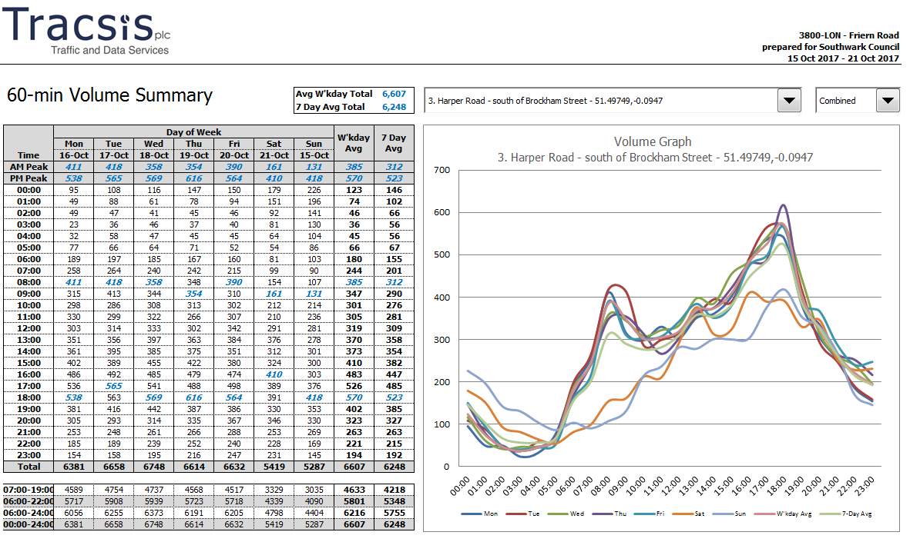
Figure 3. 2017 combined hourly flows – Middle of Harper Road

Slide 10
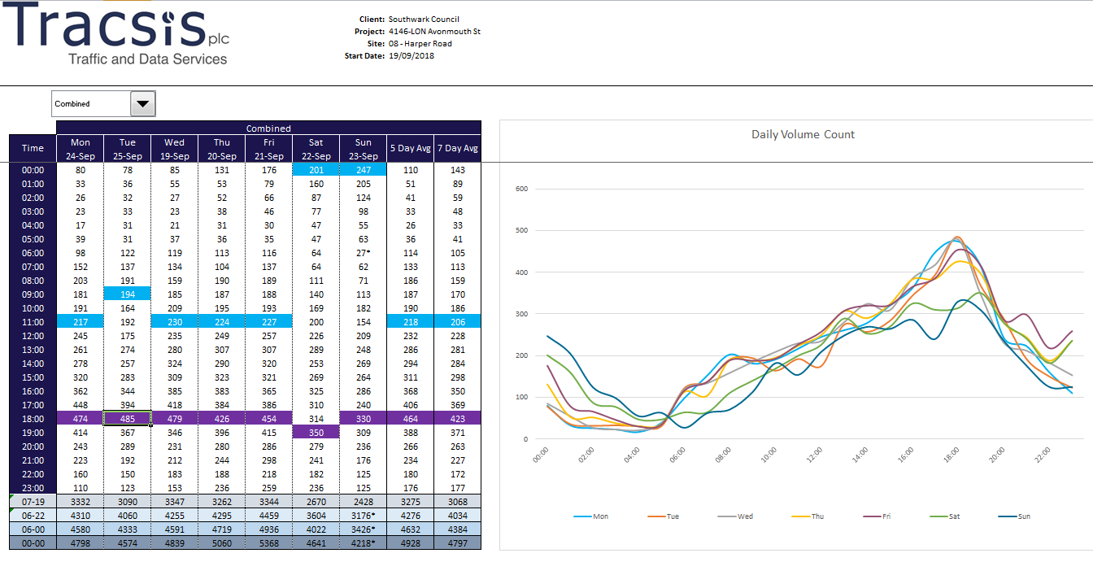
Figure 4. 2018 combined hourly flows – Middle of Harper Road

Slide 11
Conclusion
In conclusion, the width restriction has reduced traffic flows with a substantial decrease in HGV traffic in Harper Road and in the surrounding area. Peak PM traffic flows have dropped to below 500 per hour and cycle flows have also increased in most of the area.
Feedback has been given careful consideration and has informed further designs as part of proposed preliminary street improvements: the width restrictions are proposed as permanent with a more robust feature at Harper Road and the feature at Bath Terrace to be replaced with moveable bollards/gate. We are consulting on these proposals as part of the overall street improvements.

